Slide 1
Synthesizing Electrocardiogram (ECG) from Photoplethysmogram(PPG) using Generative Adversarial Networks Paper Authors: Pritam Sarkar, Ali Etemad
Presented by:
Sri Sruthi Chilukuri
San Jose State University

Slide 2
Important Links
Original paper:
https://arxiv.org/abs/2010.00104
Medium article:
https://srisruthichilukuri.medium.com/synthesizing-electrocardiogram-ecg-from-photoplethysmogram-ppg-using-generative-adversarial-60c9724d9e70
Slide share presentation:
https://www.slideshare.net/SriSruthiChilukuri/synthesizing-ecg-from-ppg-using-gans

Slide 3
Table of contents
1. ECG and PPG
2. What’s all about CardioGAN?
3. Proposed architecture
4. Experimental setup
5. Model architecture
6. Model Training
7. Performance evaluation
8. Failed cases
9. Overall quality of the paper
10. Critique, Future directions and suggestions

Slide 4
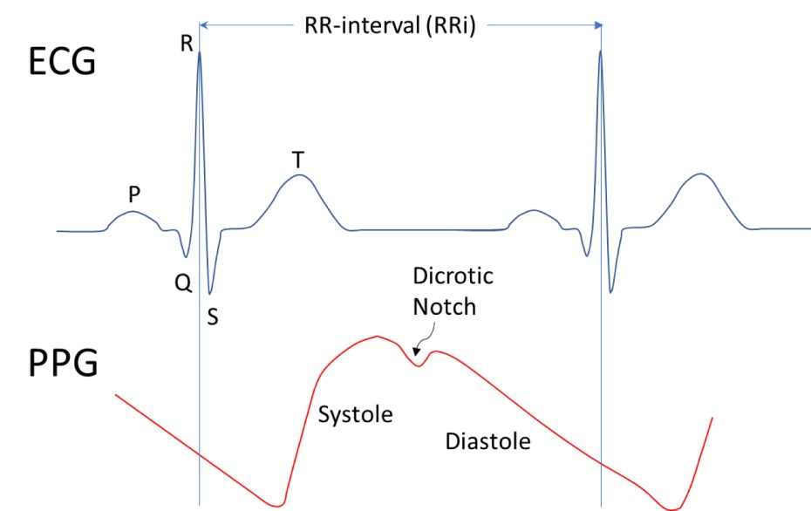
ECG and PPG
Electrocardiogram commonly known as ECG is an electrical procedure that captures the activity of a functioning heart.
Photoplethysmogram(PPG) is a technique which can measure just the blood volume changes under the skin.
Currently, very few wearable devices have ECG monitoring embedded in them.

Slide 5
What’s all about CardioGAN?
To address the problem of unavailability of continuous ECG monitoring.
A CycleGAN based architecture; trained in an unpaired manner.
Attention mechanism in generators
Multiple discriminators
Both time and frequency domains are manifested.

Slide 6
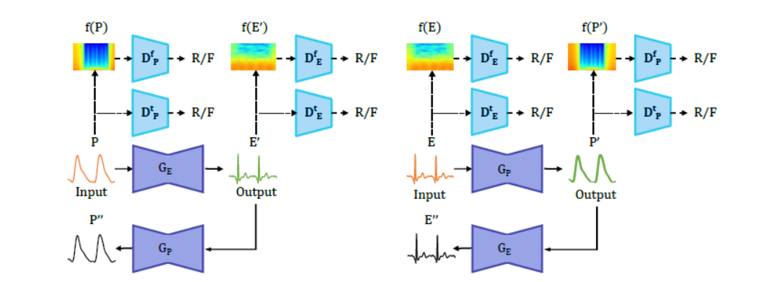
Proposed Architecture of CardioGAN

Slide 7
Experimental setup
Data Gathering and preparation:
ECG-PPG datasets that were used were BIDMC, CAPNO, DALIA, WESAD.
Each of them had varying attributes, different patient records and even different sampling frequencies.
Followed a multi-corpus approach.
Band pass filters were applied .
Min-Max normalization over signal data to introduce homogeneity.

Slide 8
Model architecture
GENERATOR
Attention U-Net architecture was used as generator.
Encoder contains 6 blocks with various sized filters.
Layer normalization was applied.
LeakyReLu activation function
Decoder contains similar architecture with Relu on de-convolution layers.

Slide 9
2. DISCRIMINATOR
Dual discriminators were used to classify data in time and frequency domains.
Each of 4 convolution layers is followed by normalization layer.
LeakyReLu activation function was used except for first layer.
Single channel convolution layer as output

Slide 10
Model Training
CardioGAN trained on Nvidia RTX GPU using TensorFlow.
80-20% train and test split on all four datasets.
CardioGAN trained in unpaired manner by shuffling ECG and PPG data.
Adam optimizer was used to train generators and discriminators.
Total training: 15 epochs.

Slide 11
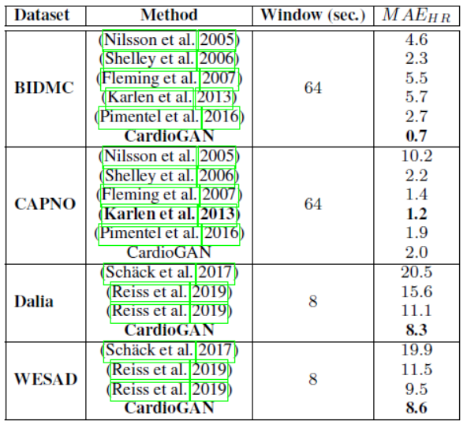
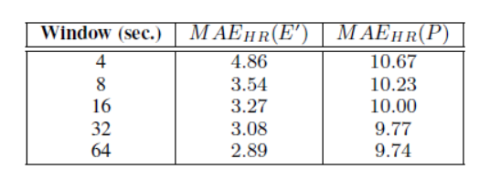
Performance evaluation

Slide 12
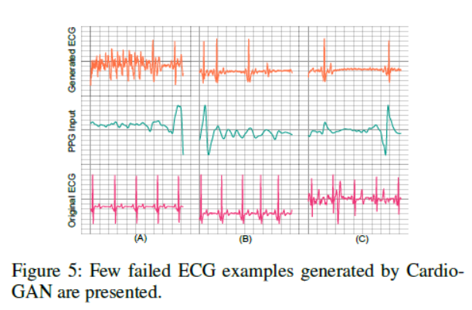
Failed cases
Few PPG signals input to the model had very pure quality.
Highly noisy PPG inputs generate ECG signals of very low quality.

Slide 13
Future work
Generated ECG signals’ usage can be widened.
Multi-lead ECG can be further studied to extract more cardiac information.
Information that cannot be read by single channeled PPG signals can be extracted.

Slide 14
The overall quality of the paper
Straightforward approach
Details about CardioGAN were well described.
More graphical representations of the several architectural layers could have been provided.

Slide 15
Critique, Future directions and suggestions
Impact of low-quality inputs could have been discussed in detail.
This experiment has the potential to impact the medical field in a positive way.
A low-cost solution is of utmost necessity in such a scenario whether in the form of wearable devices or compact devices.
This model can be integrated with a wearable device like a wristwatch to put to real-time use to test its authenticity and reliability.

Slide 16
References
“CardioGAN: Attentive Generative Adversarial Network with Dual Discriminators for Synthesis of ECG from PPG” by Pritam Sarkar, Ali Etemad, 30 Sept 2020; https://arxiv.org/abs/2010.00104
Thank You.

